Slide 1
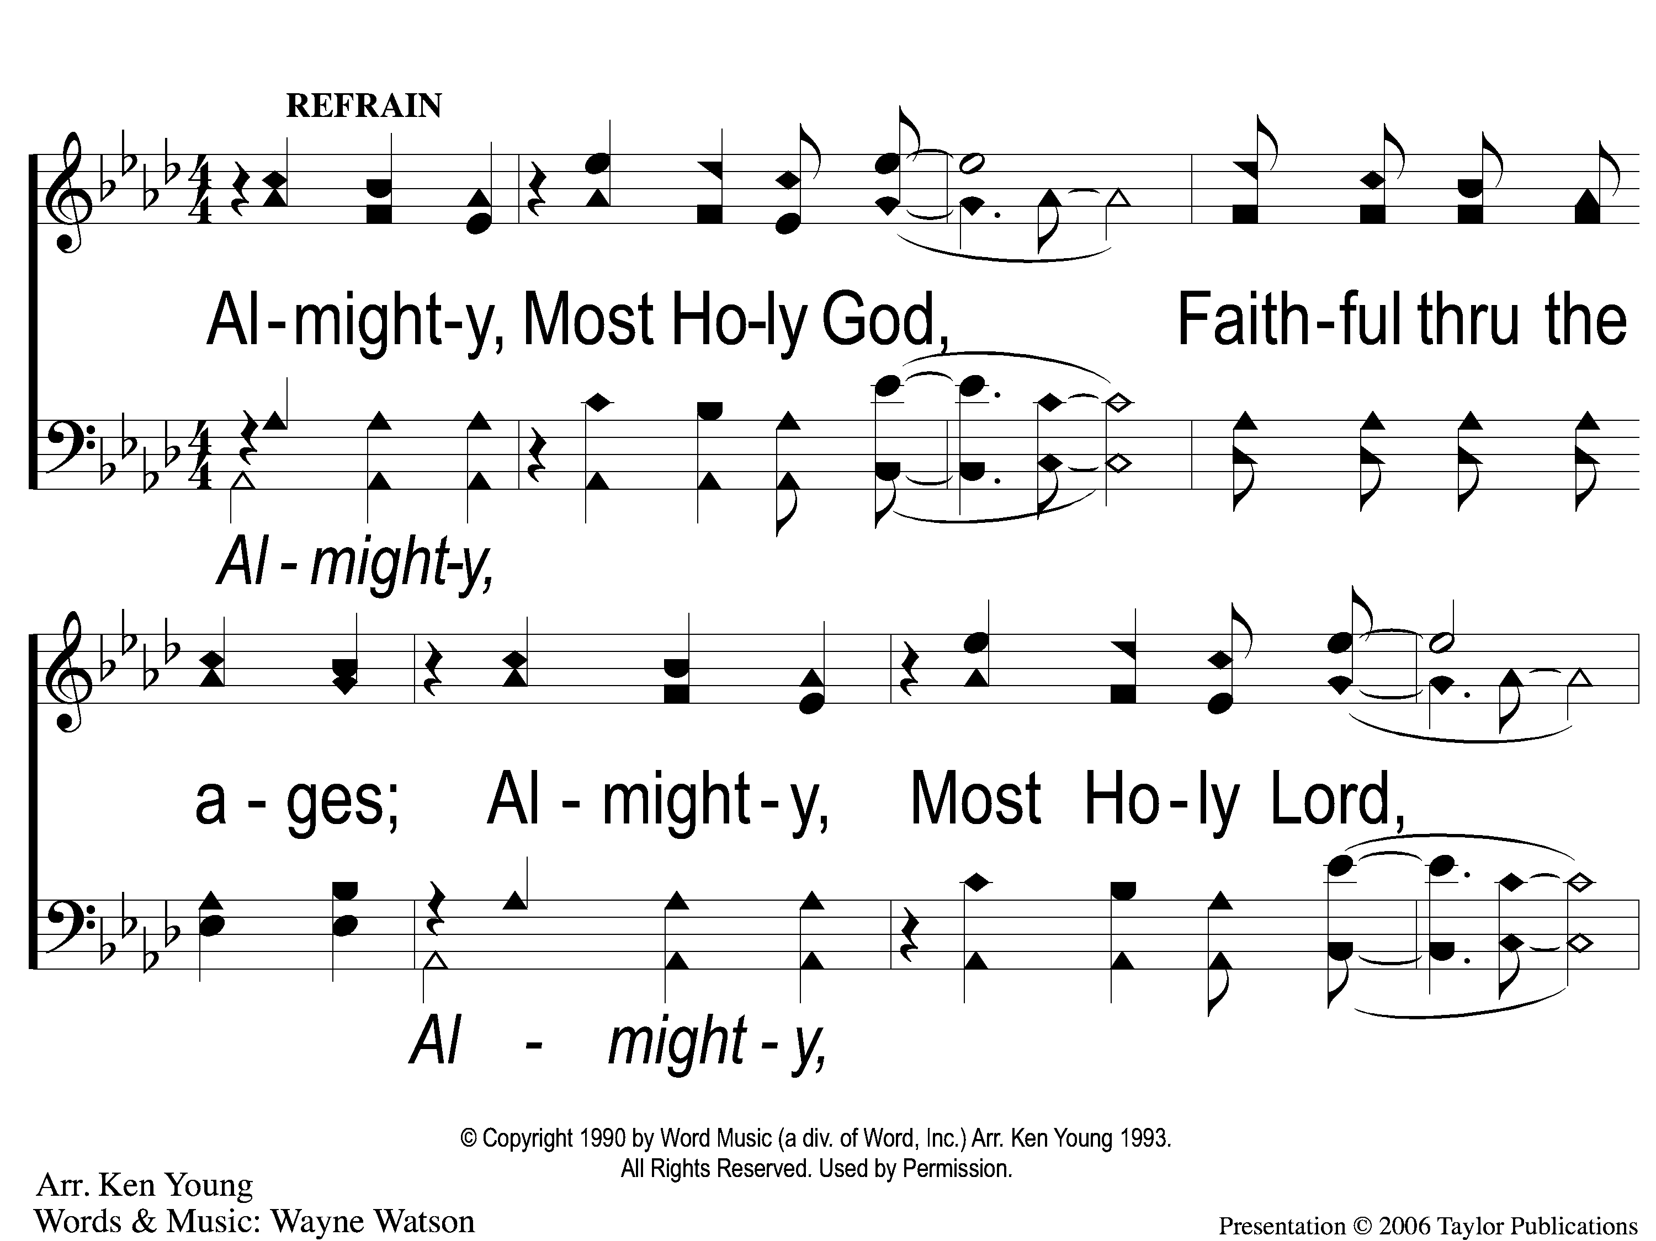
C-1 Almighty
Almighty
105

Slide 2
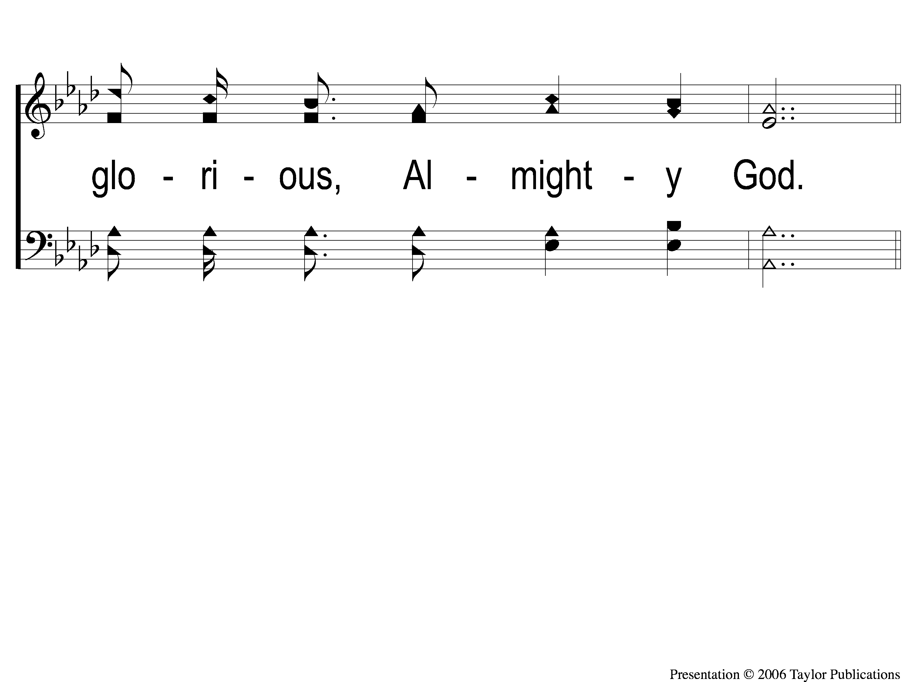
C-2 Almighty
Almighty
105

Slide 3
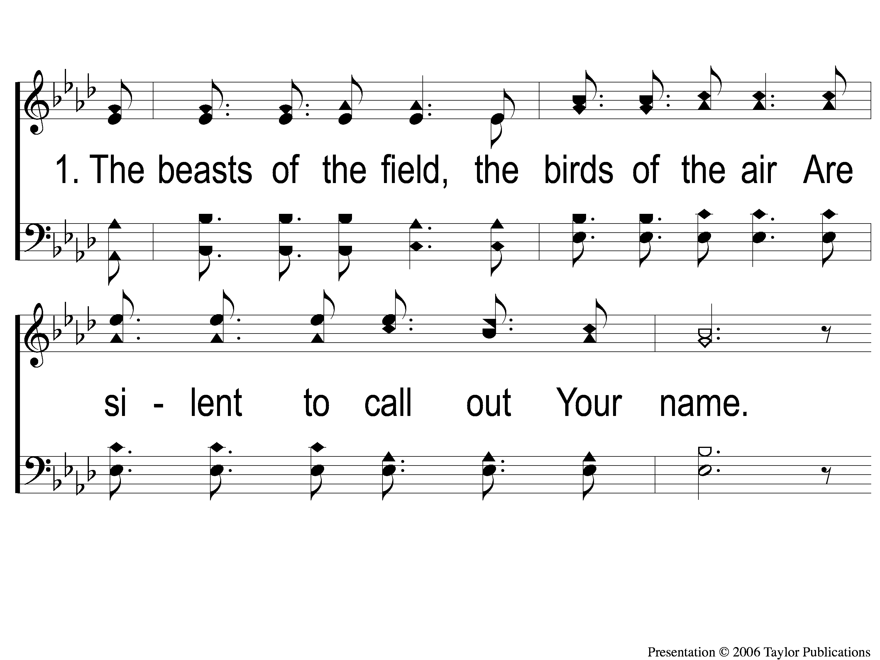
1-1 Almighty
Almighty
105

Slide 4
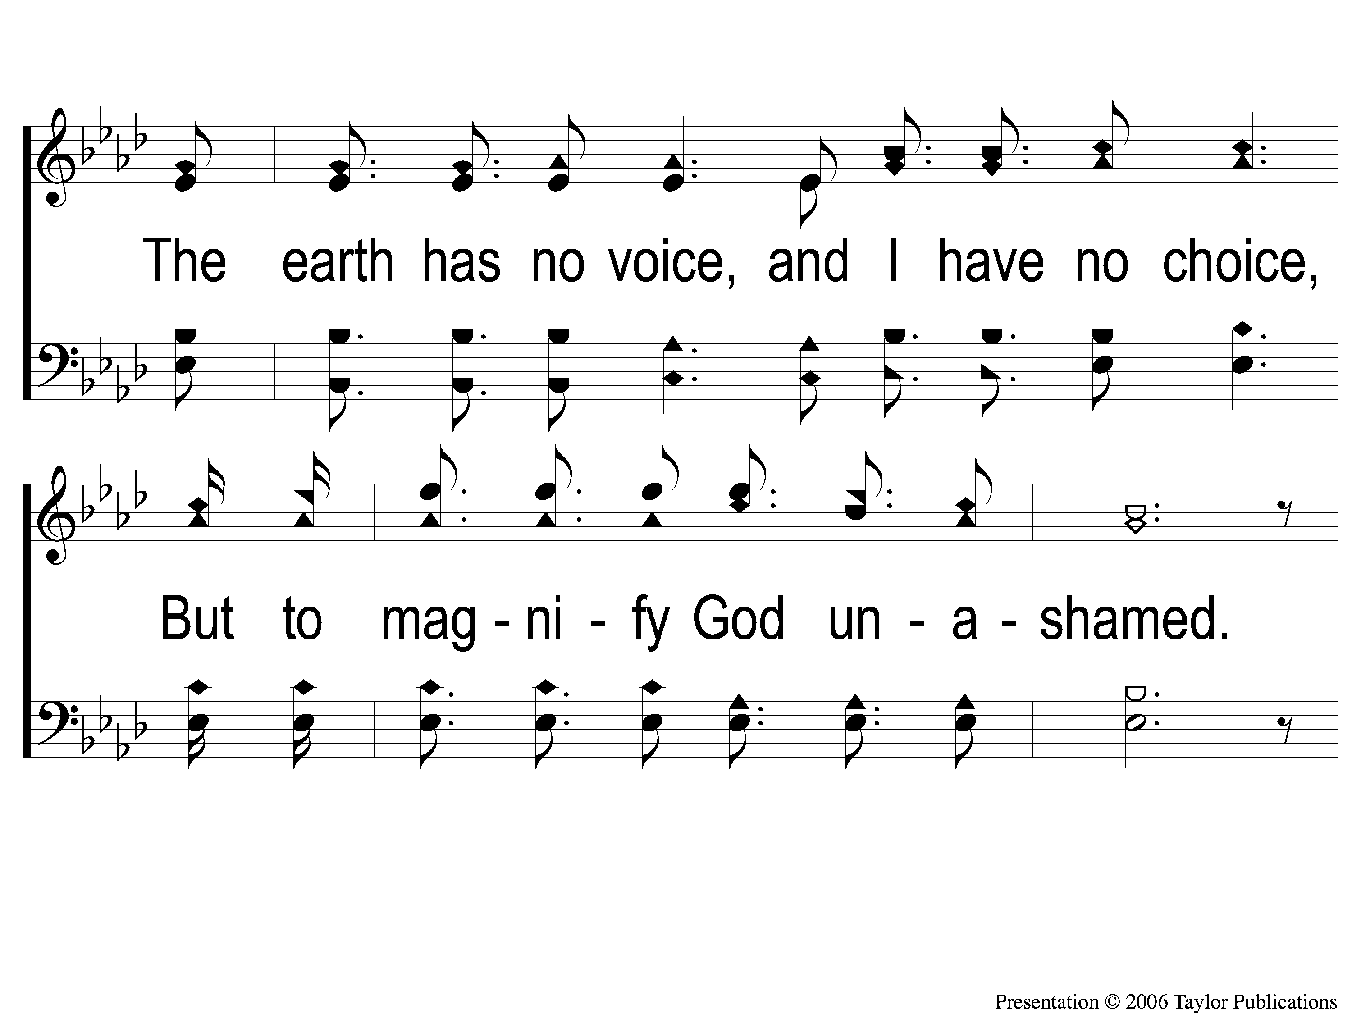
1-2 Almighty
Almighty
105

Slide 5
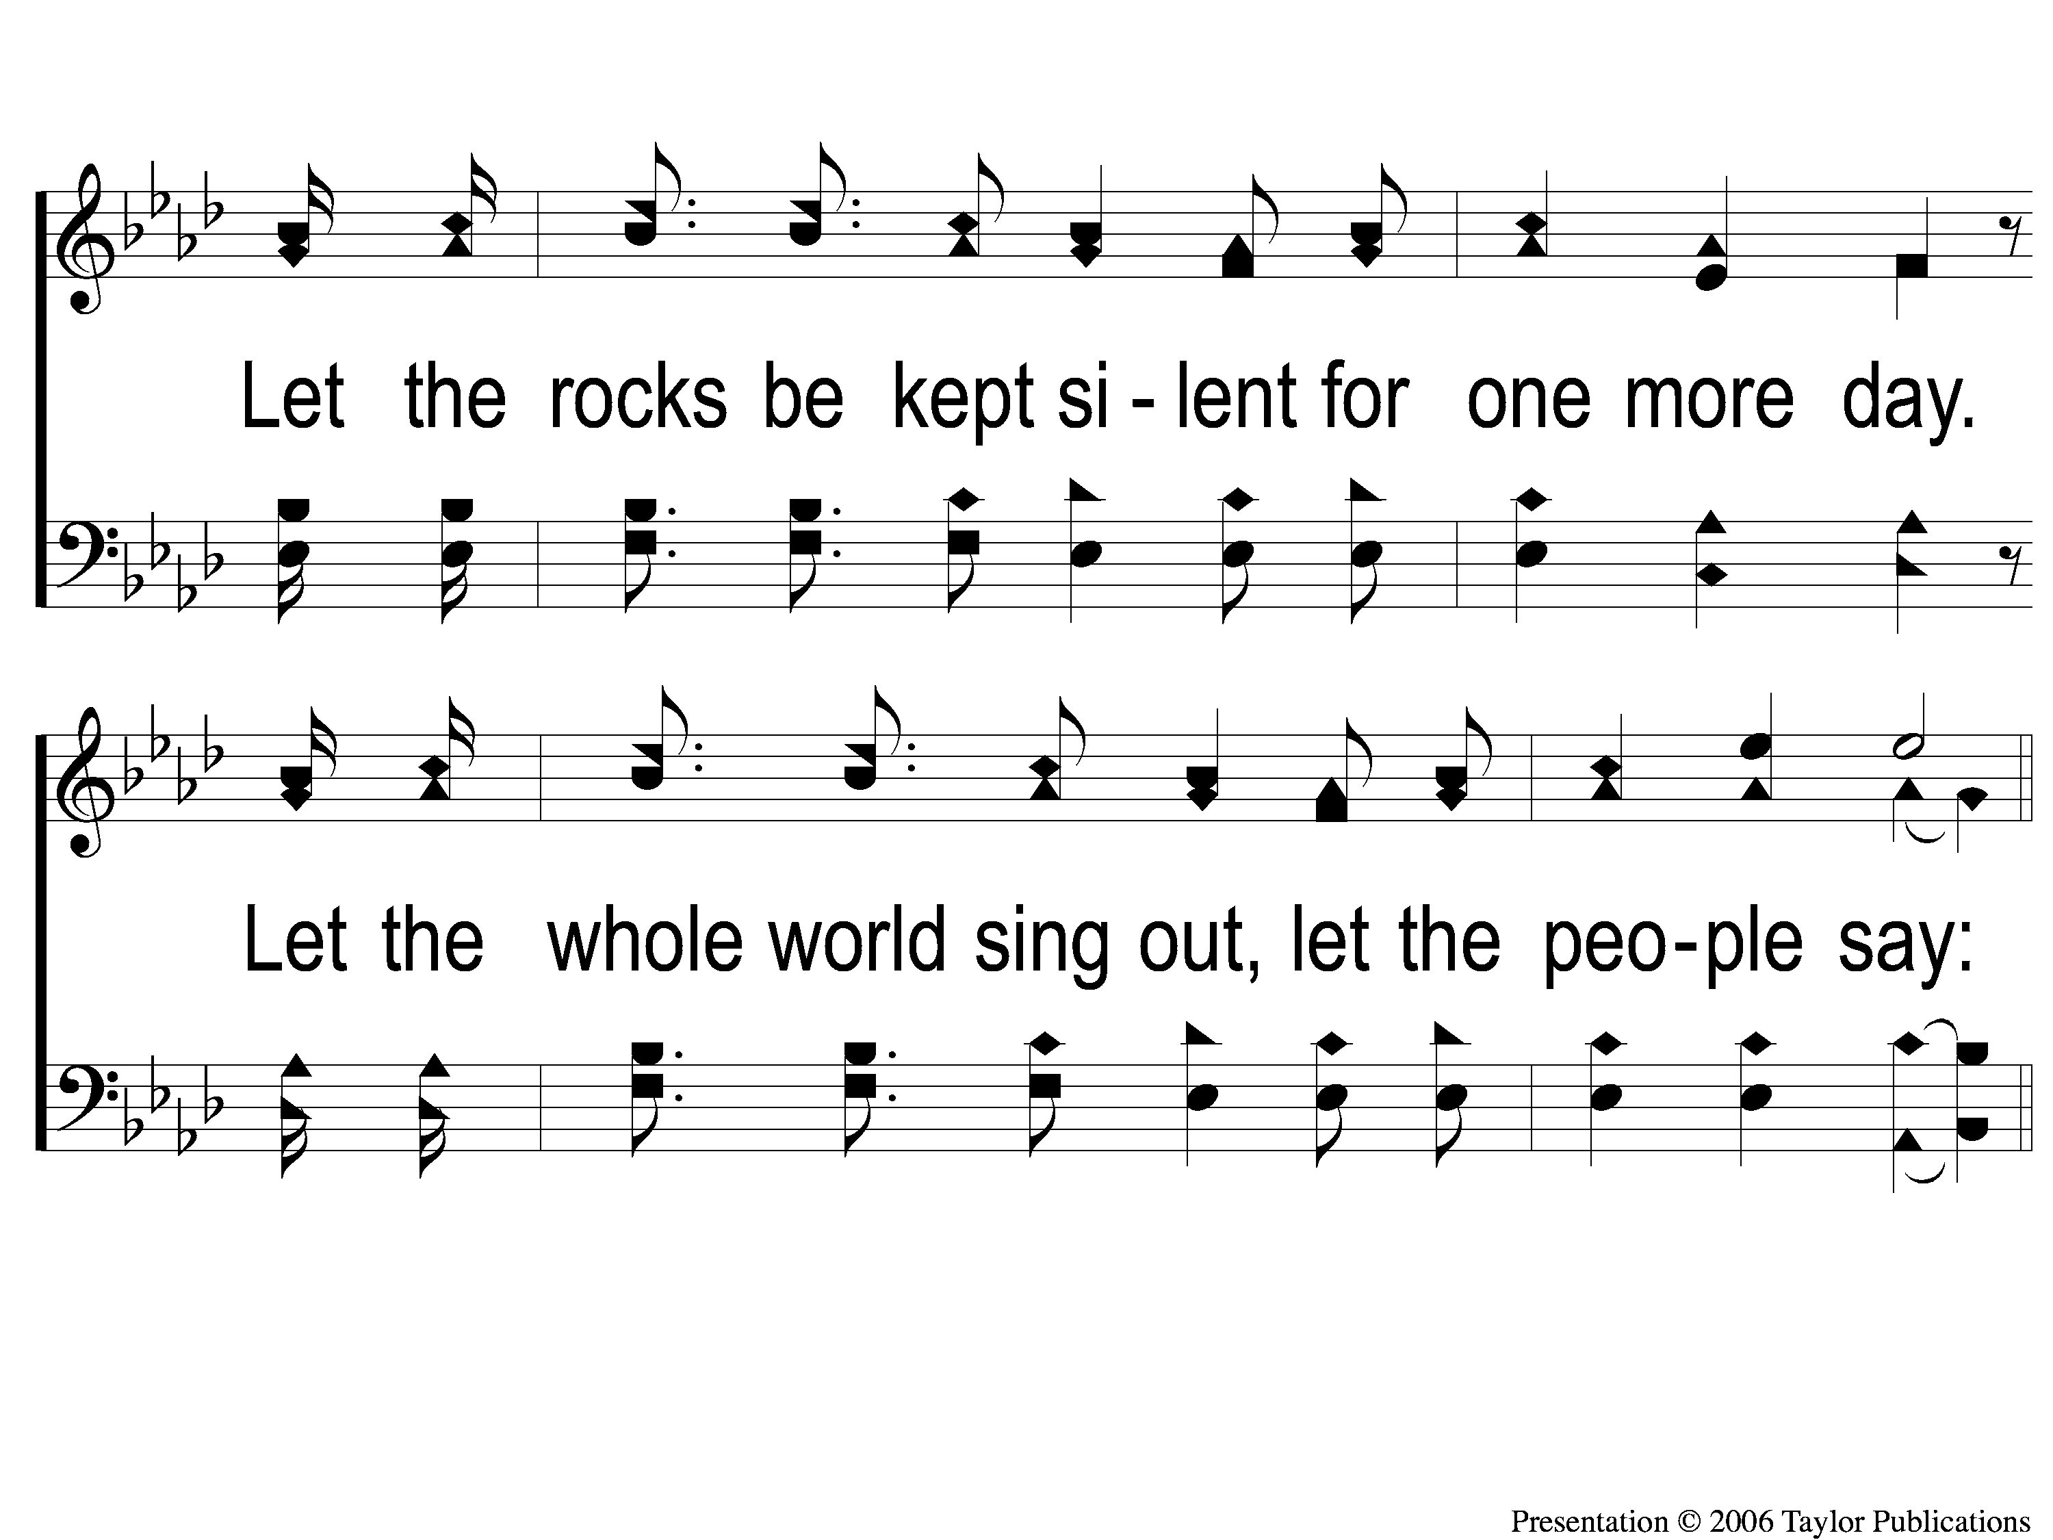
1-3 Almighty
Almighty
105

Slide 6
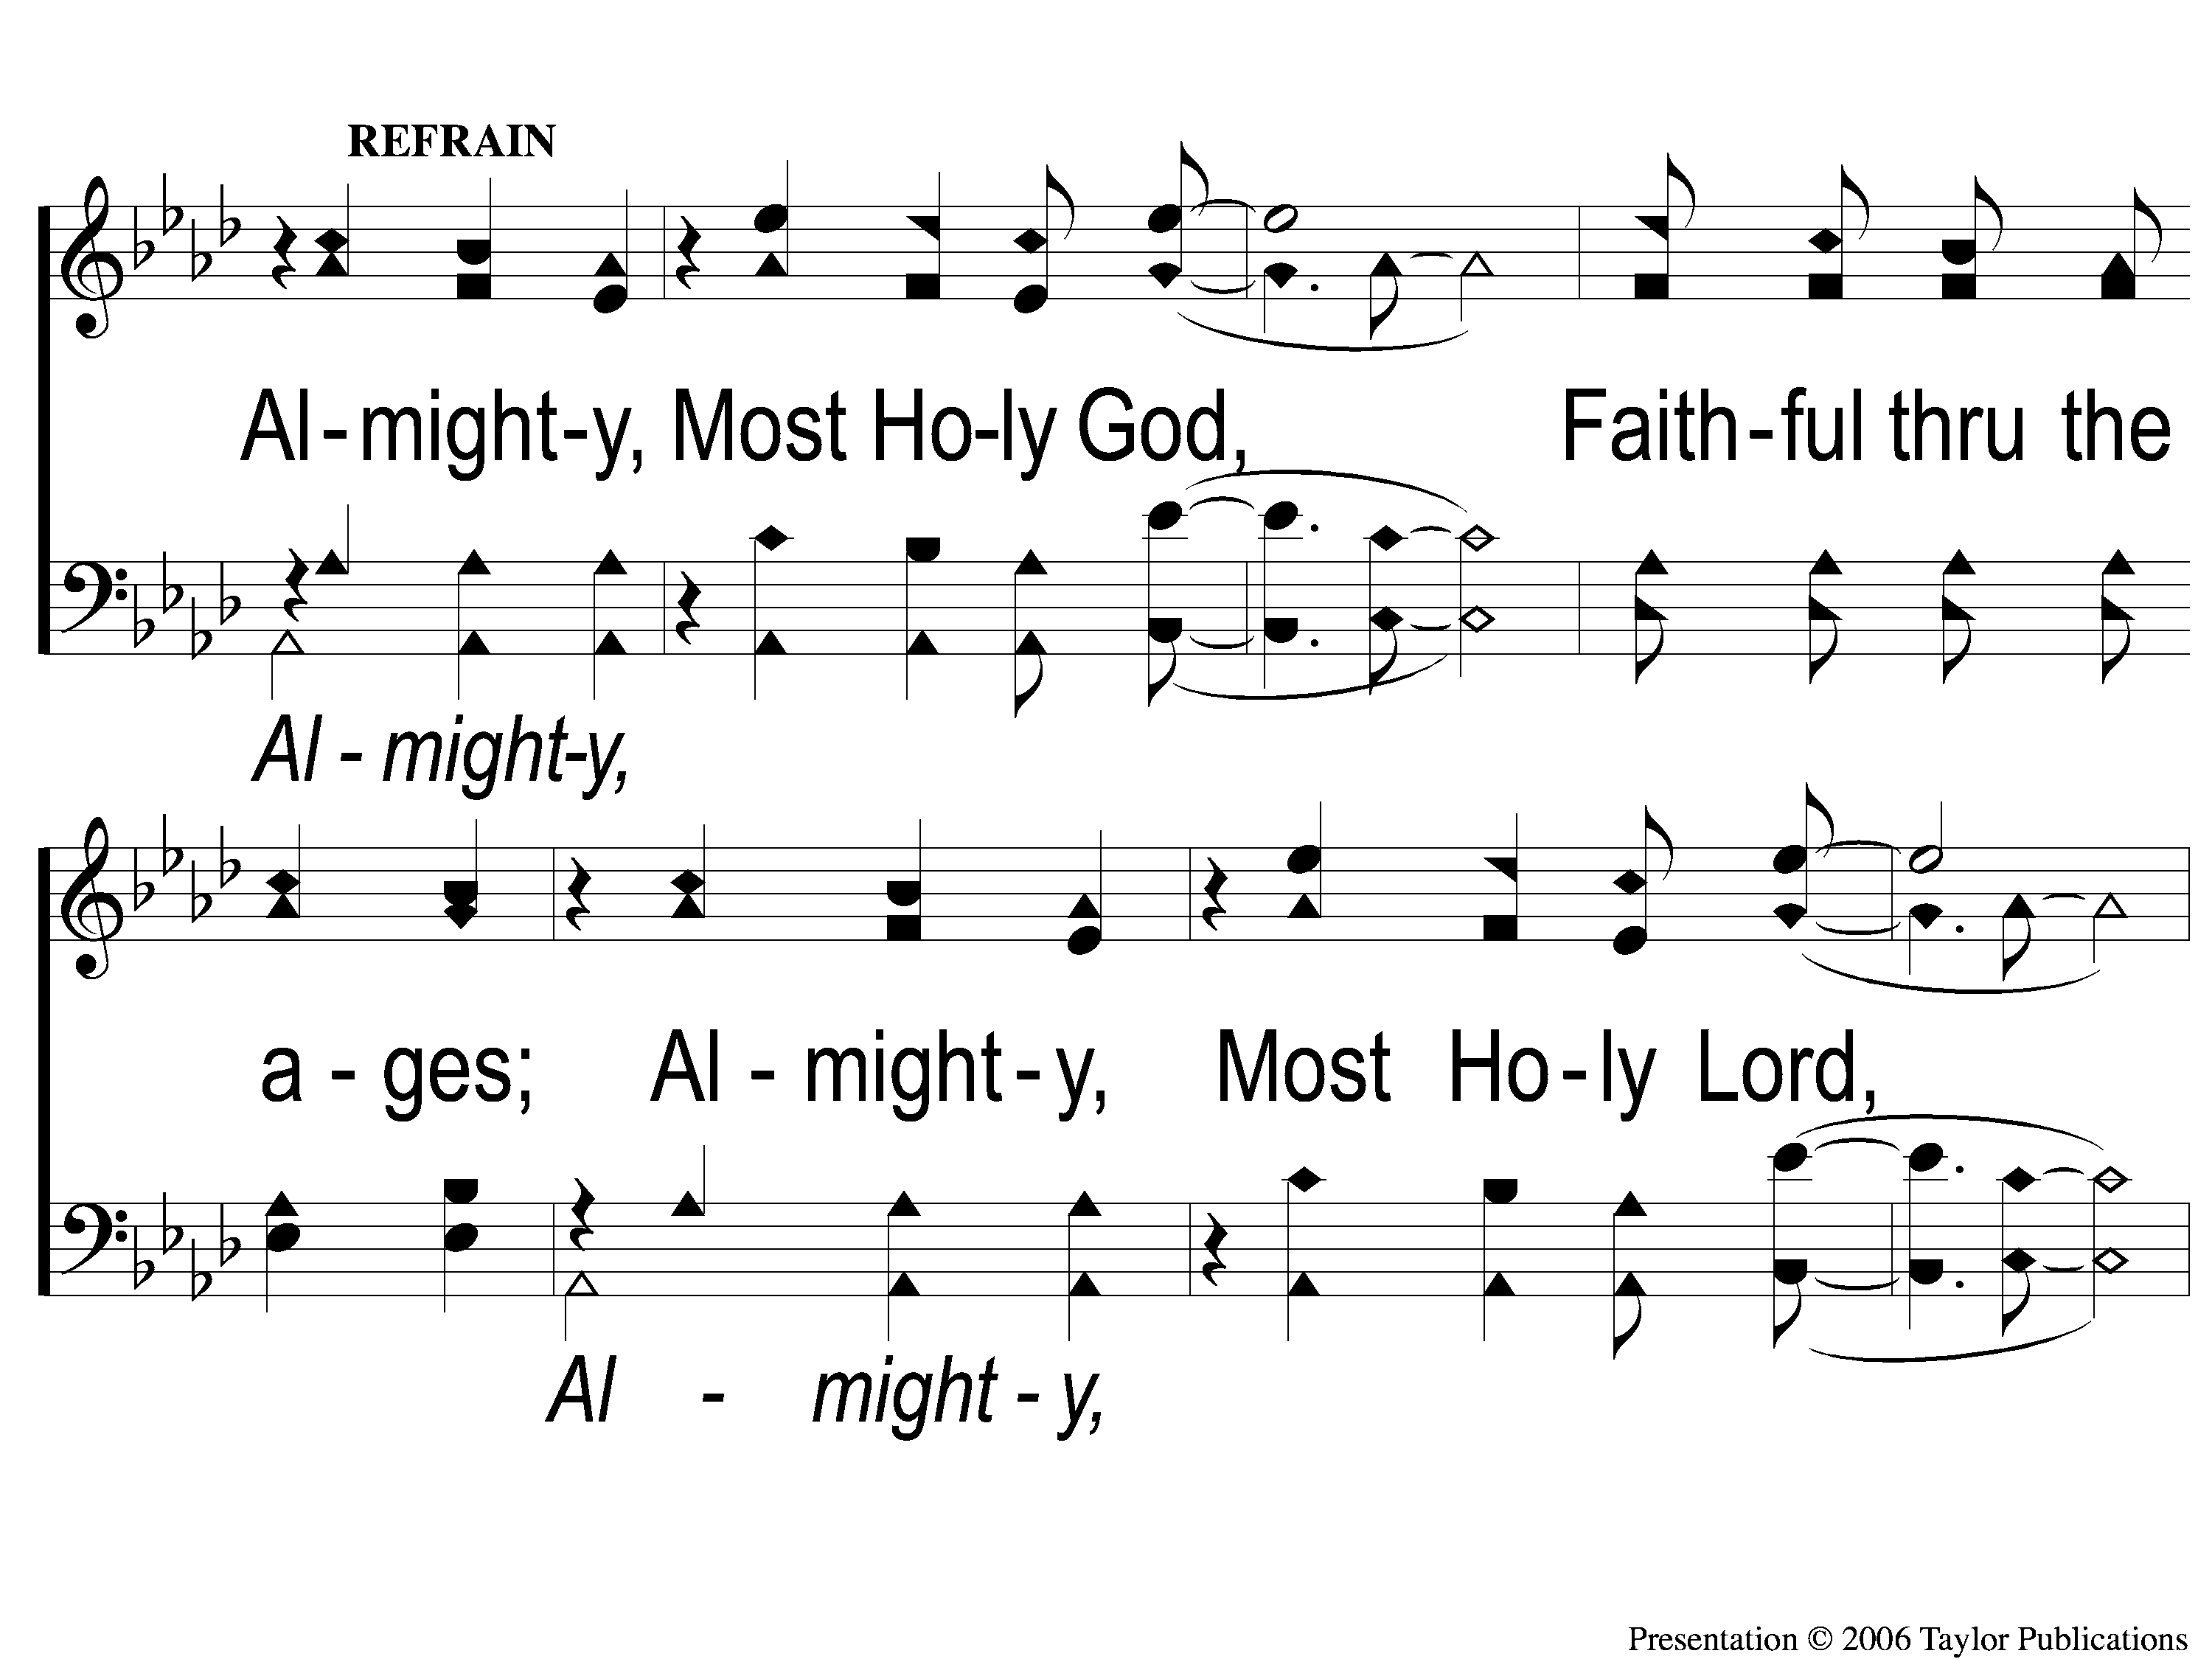
2c-1 Almighty
Almighty
105

Slide 7
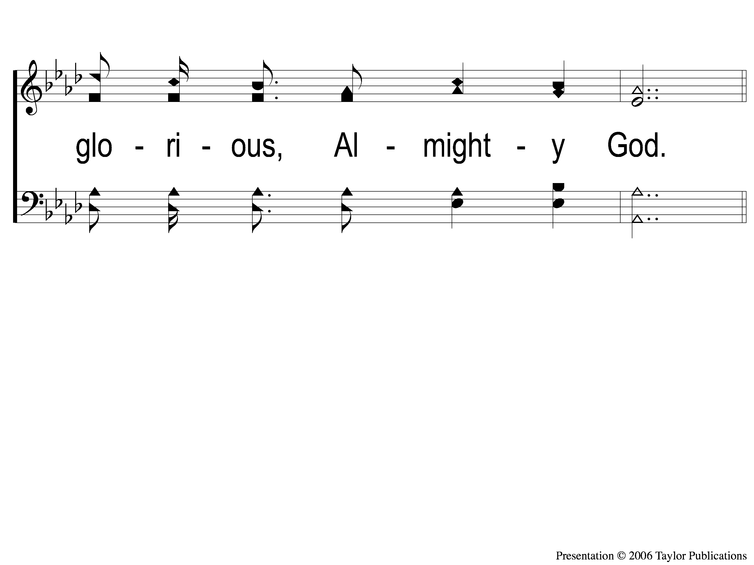
2c-2 Almighty
Almighty
105

Slide 8
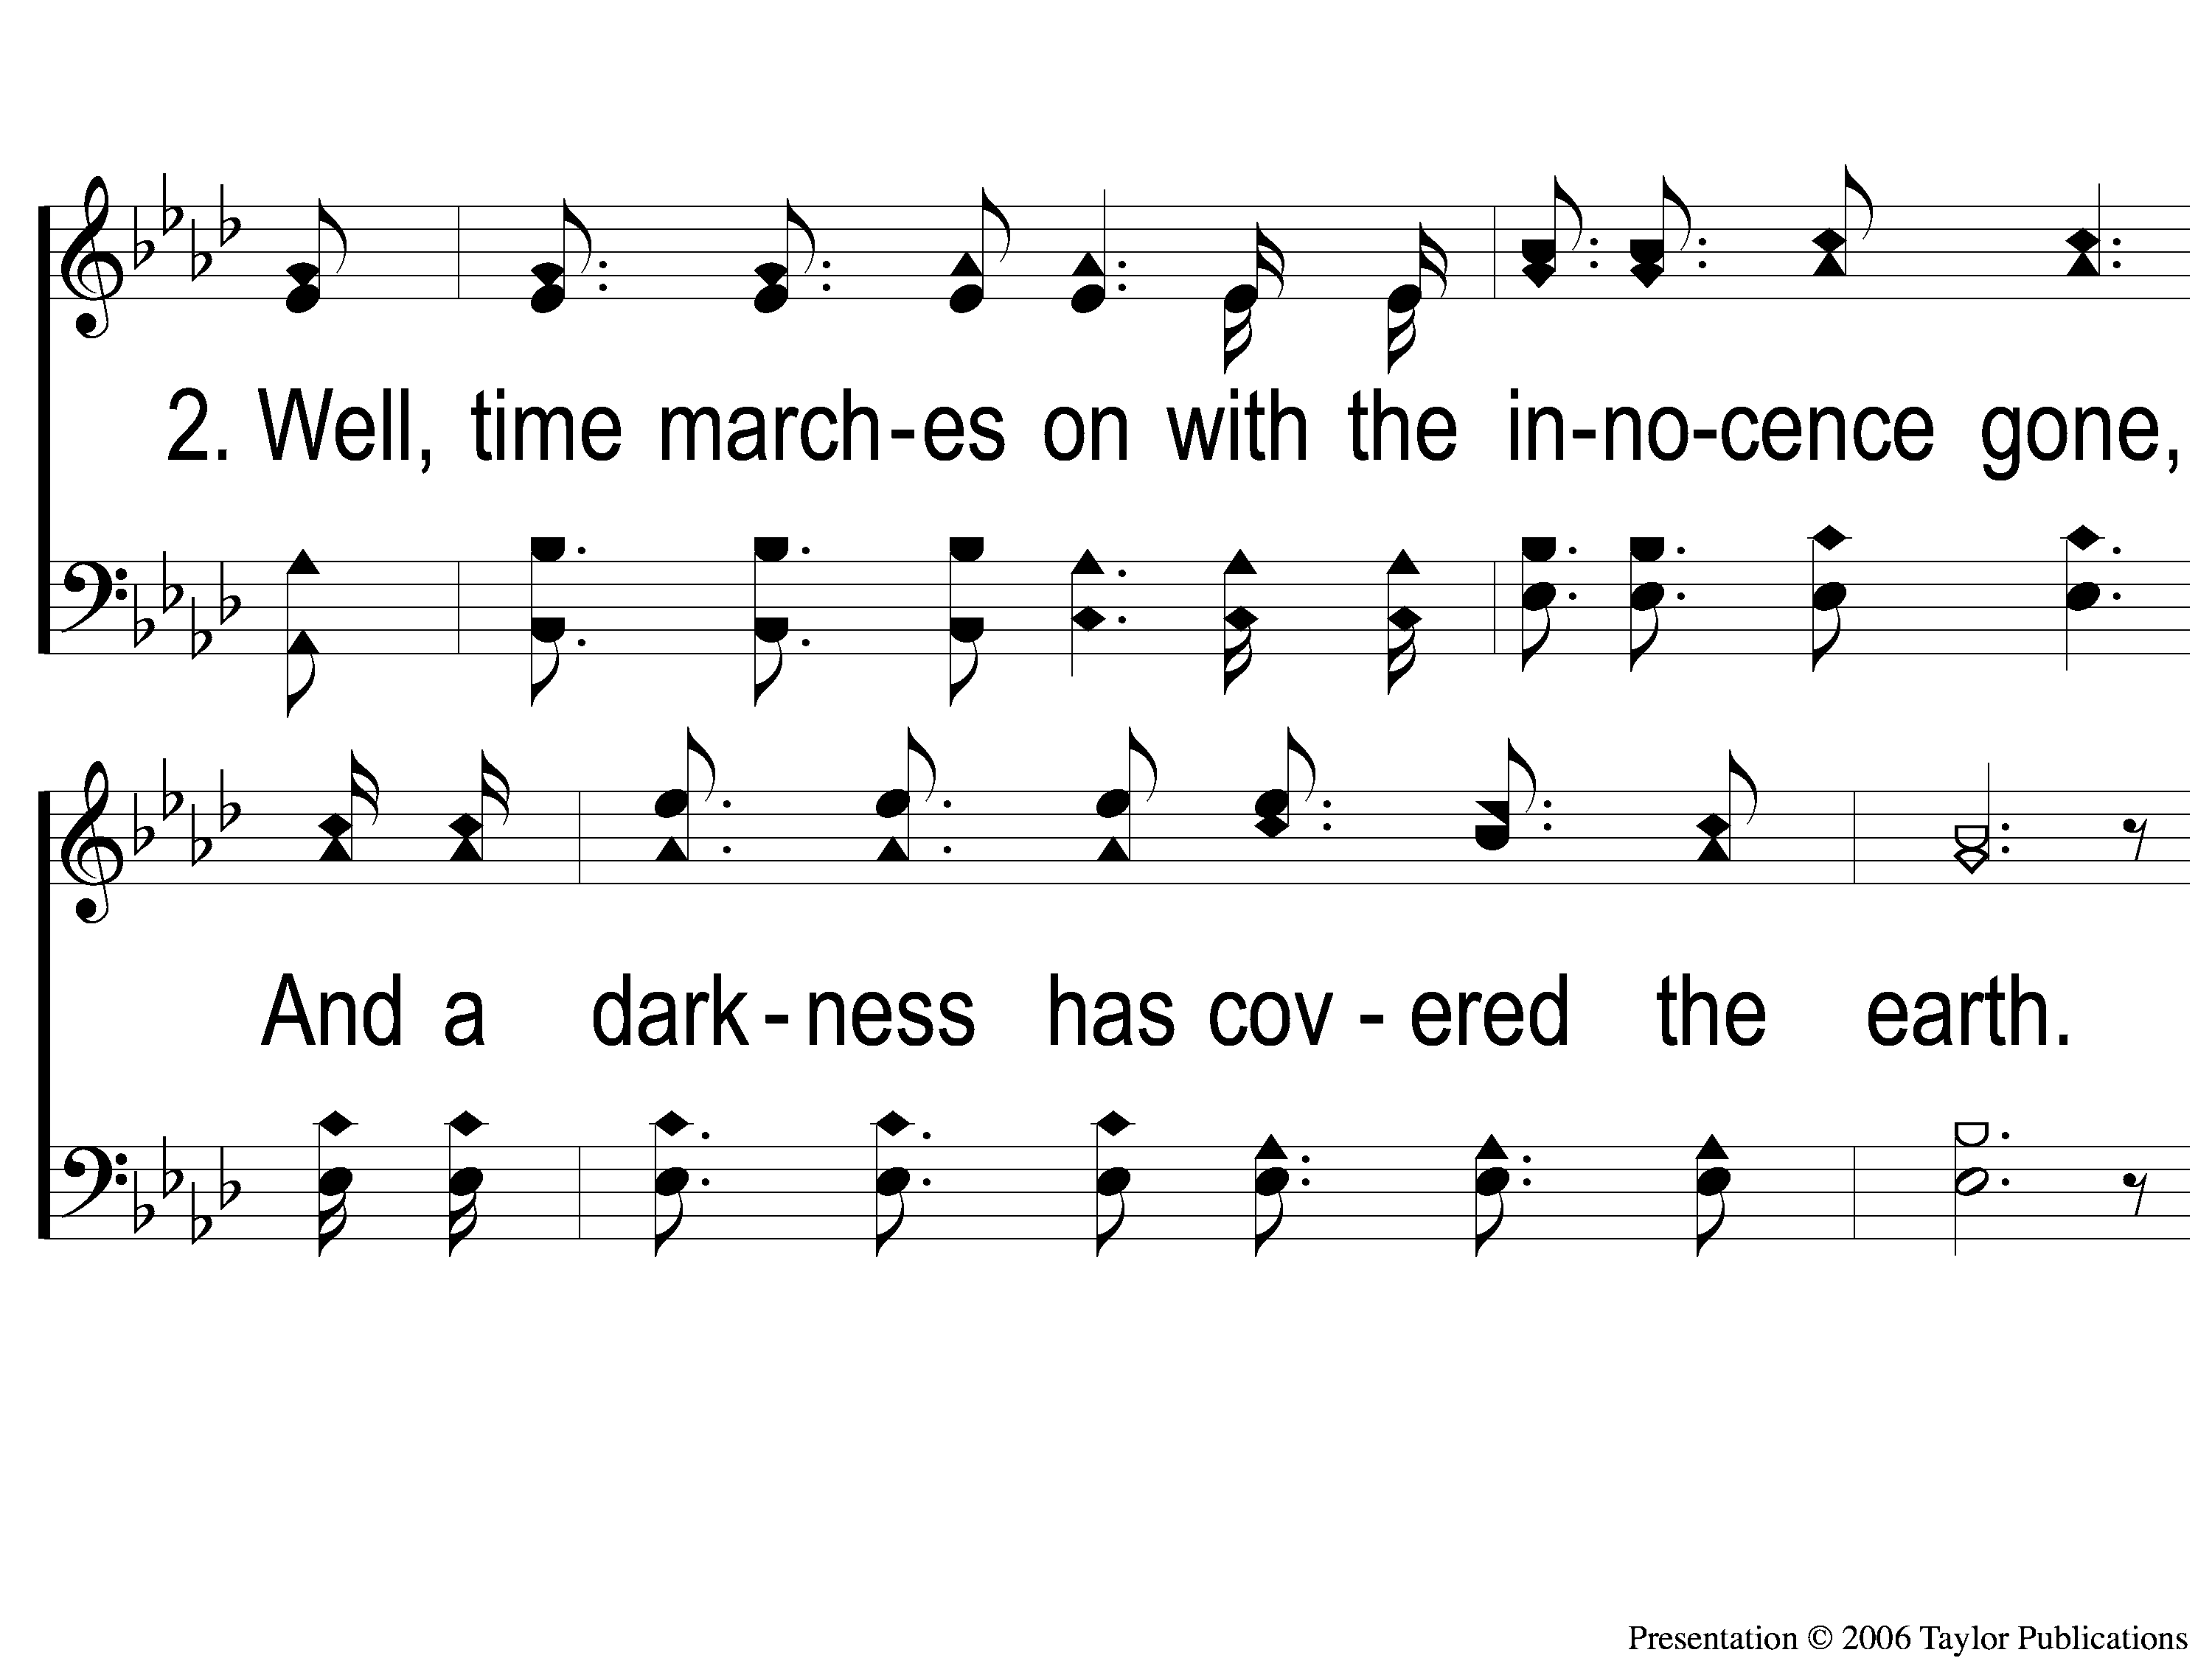
2-1 Almighty
Almighty
105

Slide 9
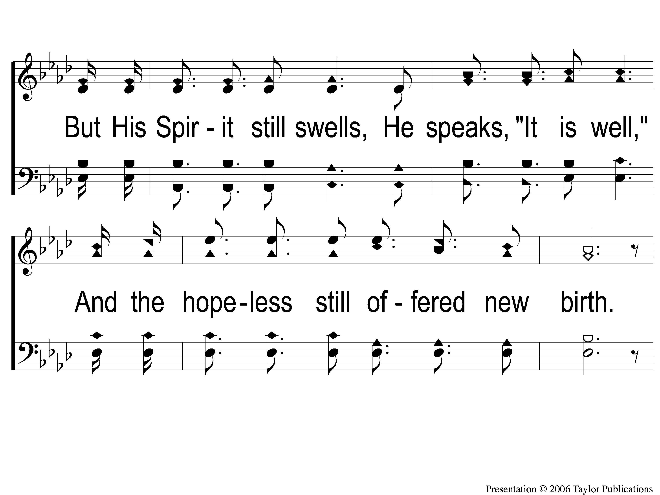
2-2 Almighty
Almighty
105

Slide 10
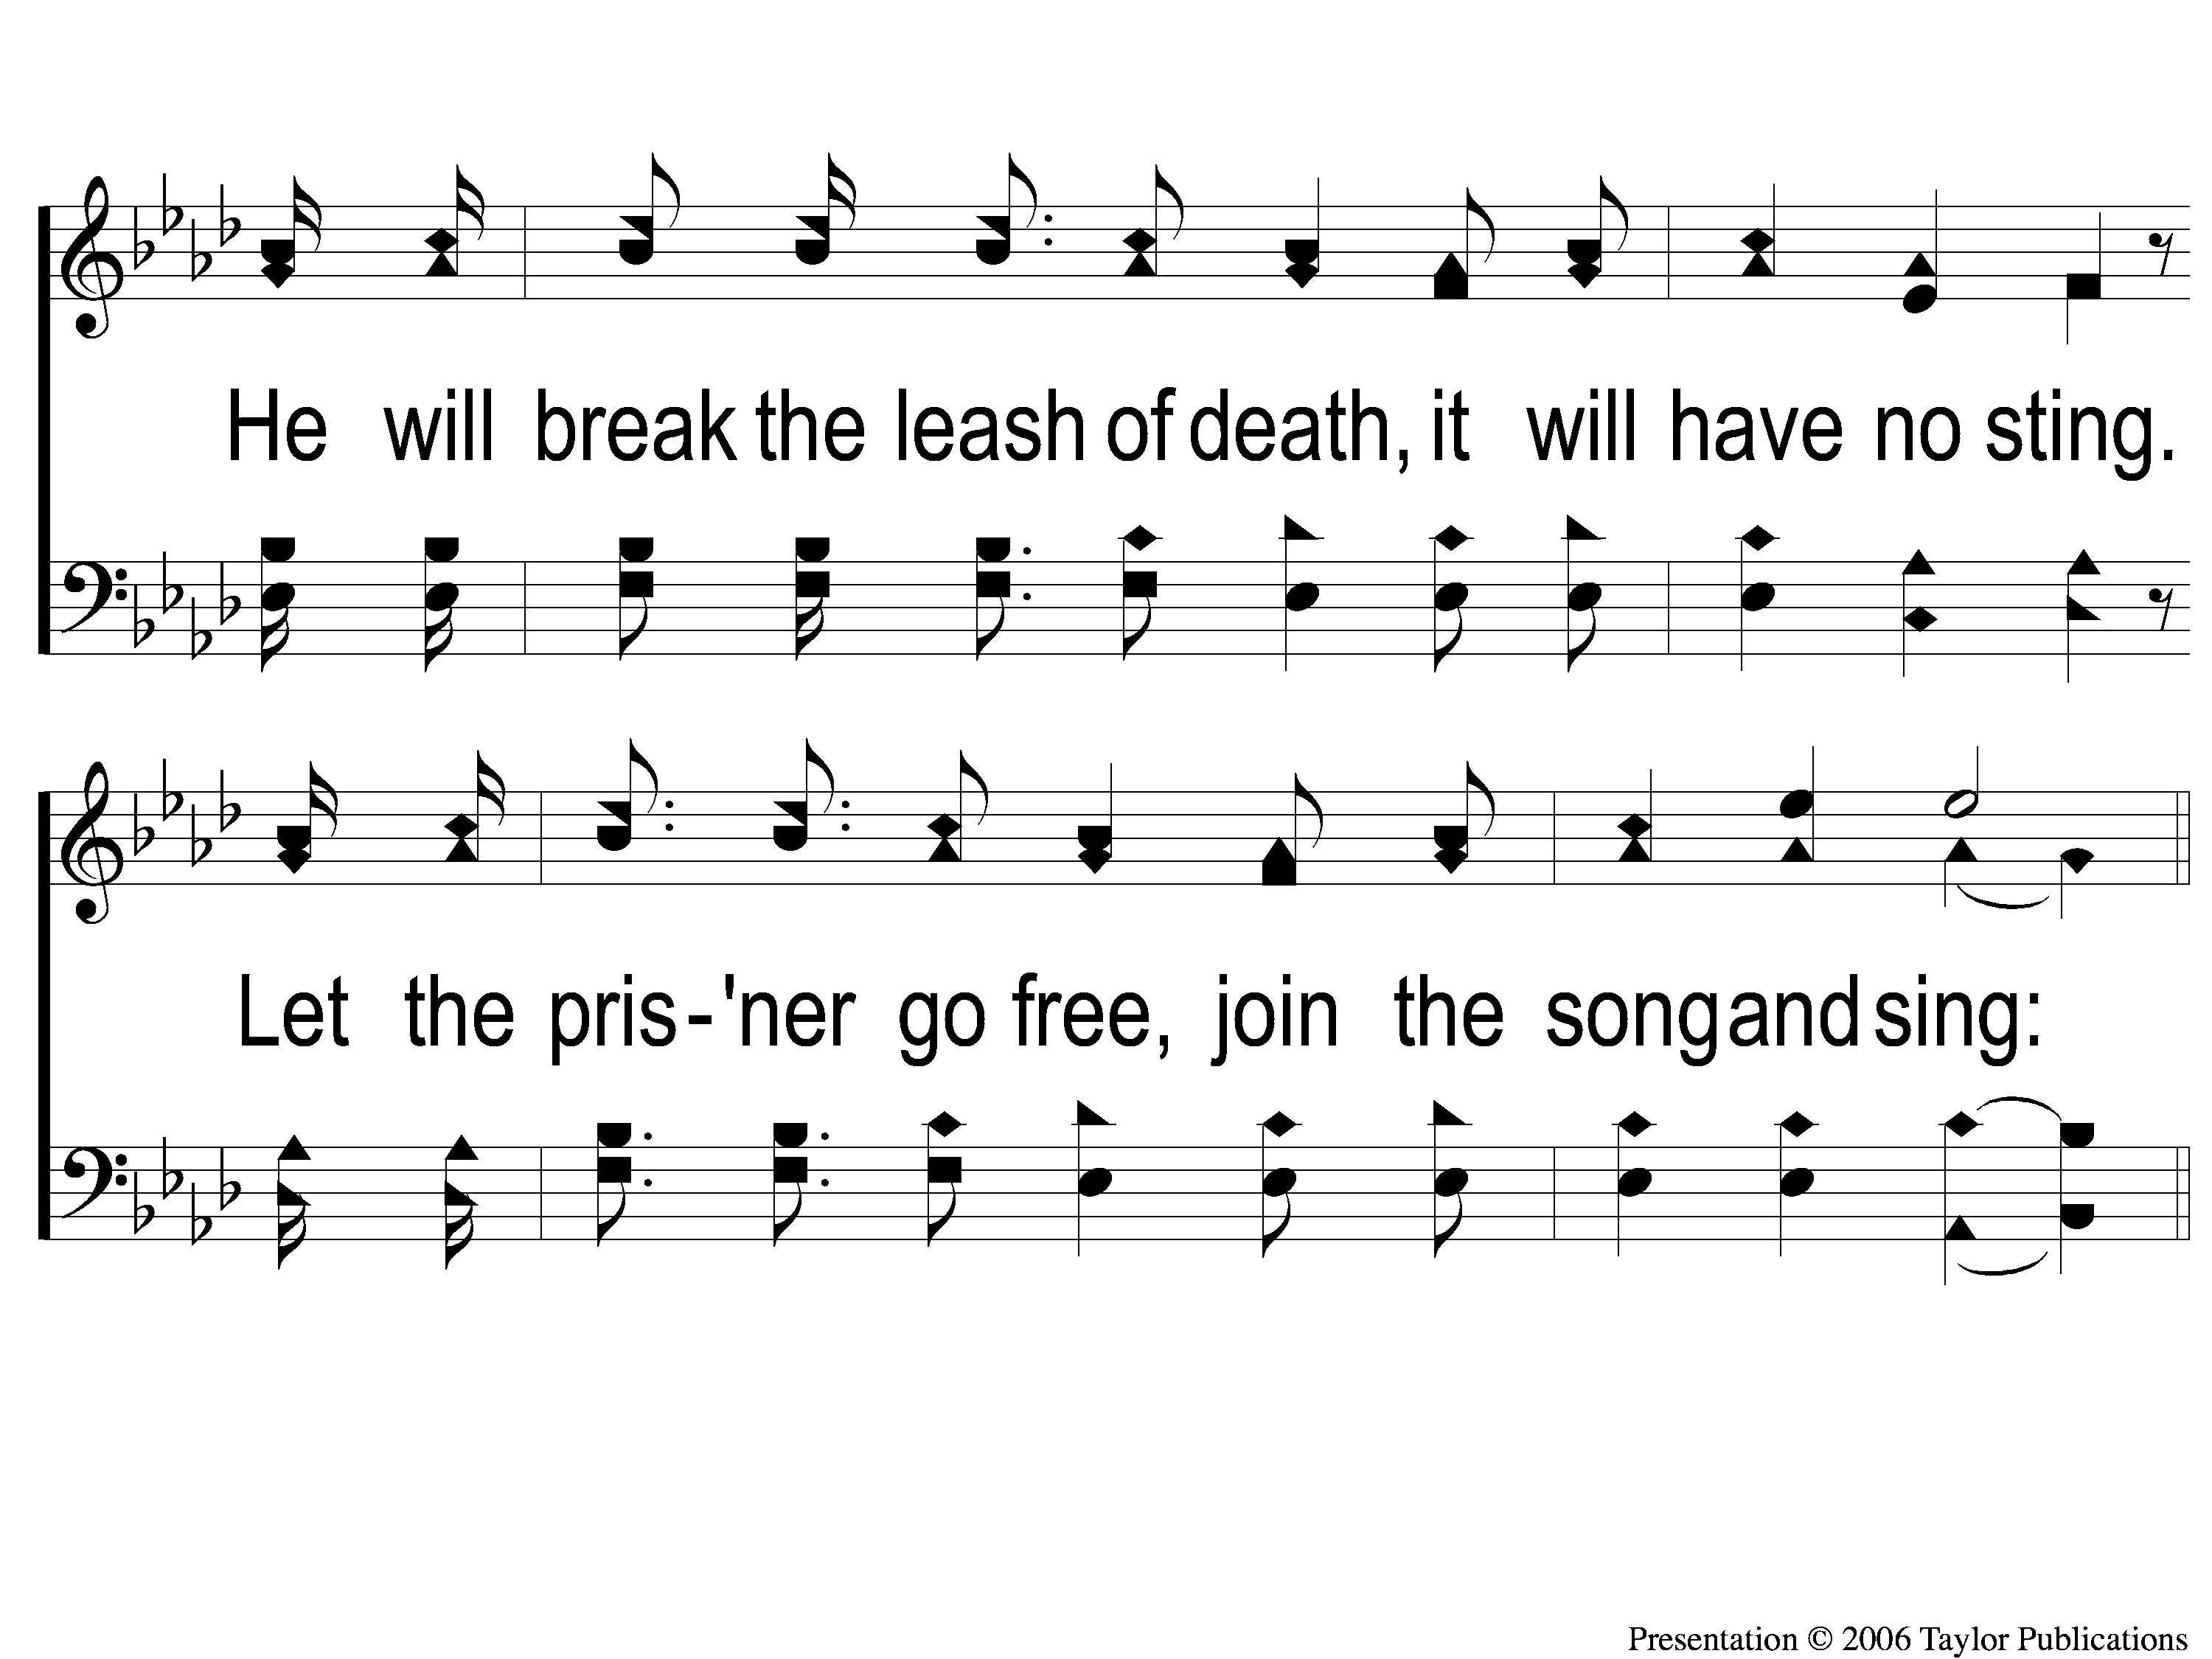
2-3 Almighty
Almighty
105

Slide 11
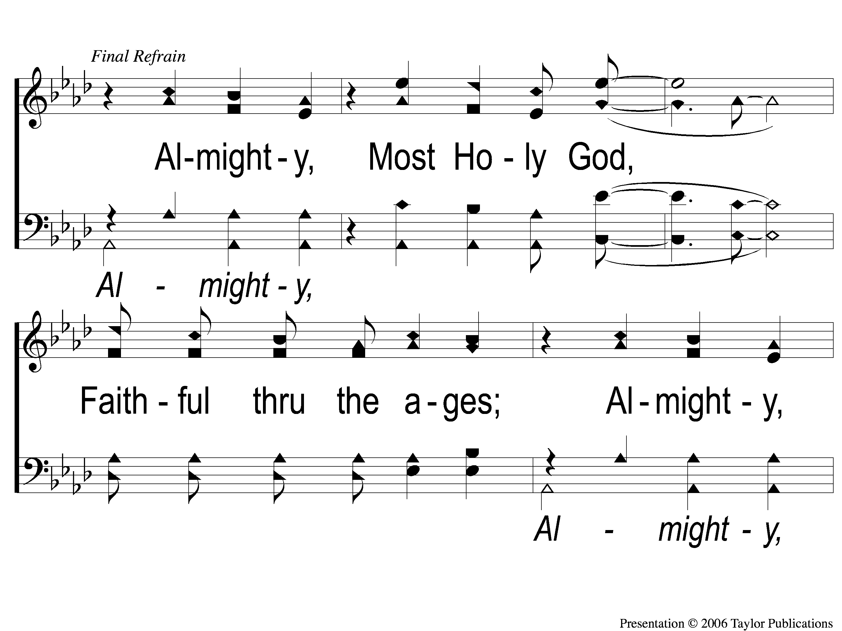
3c-1 Almighty
Almighty
105

Slide 12
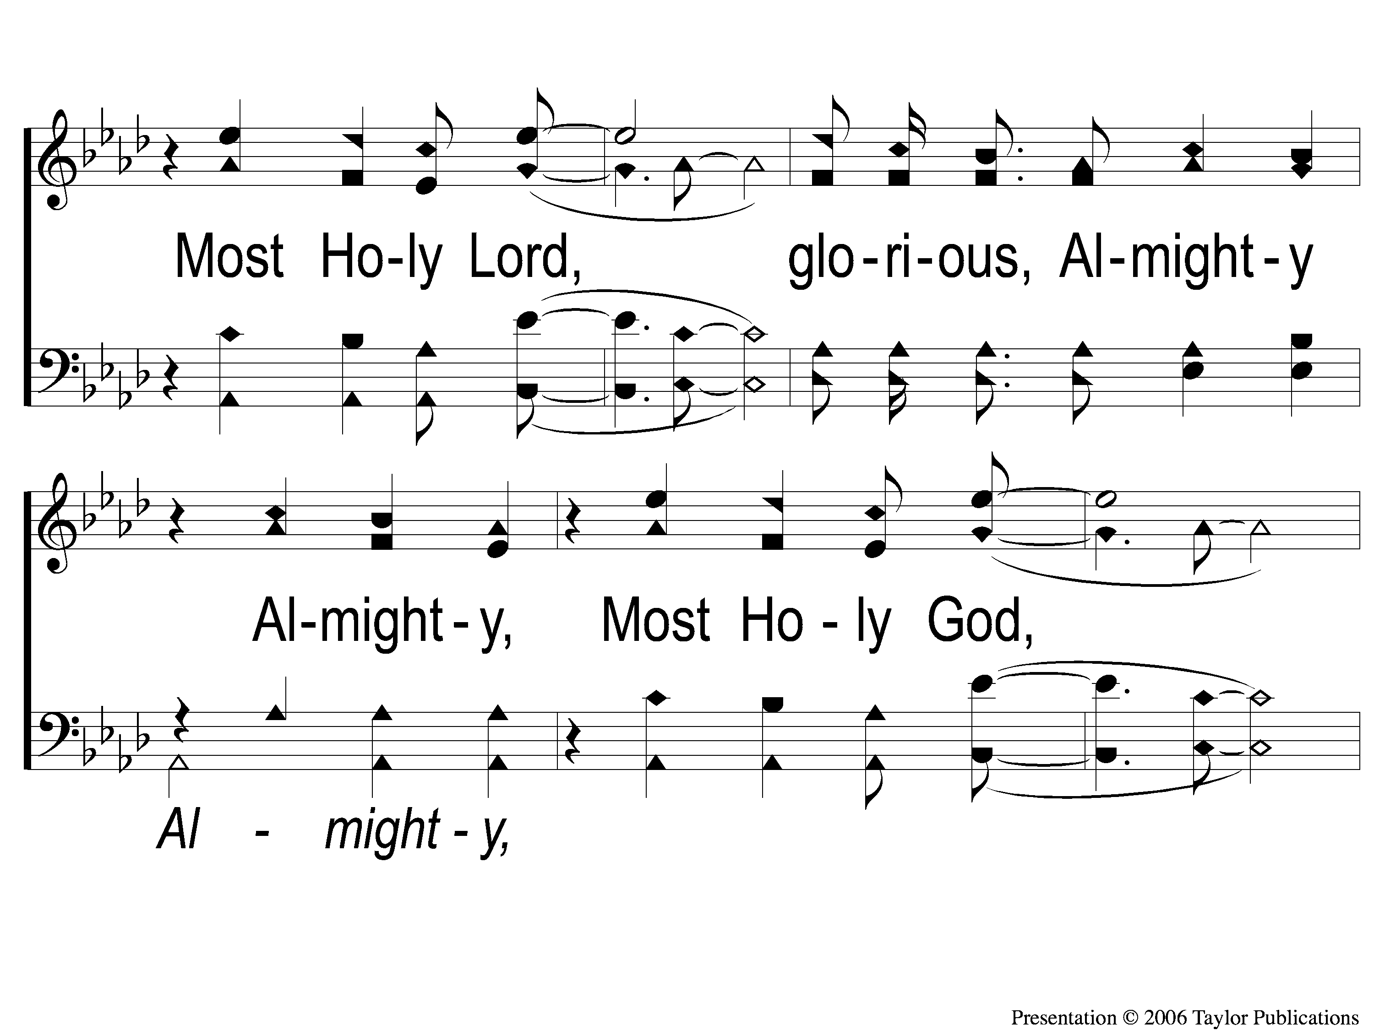
3c-2 Almighty
Almighty
105

Slide 13
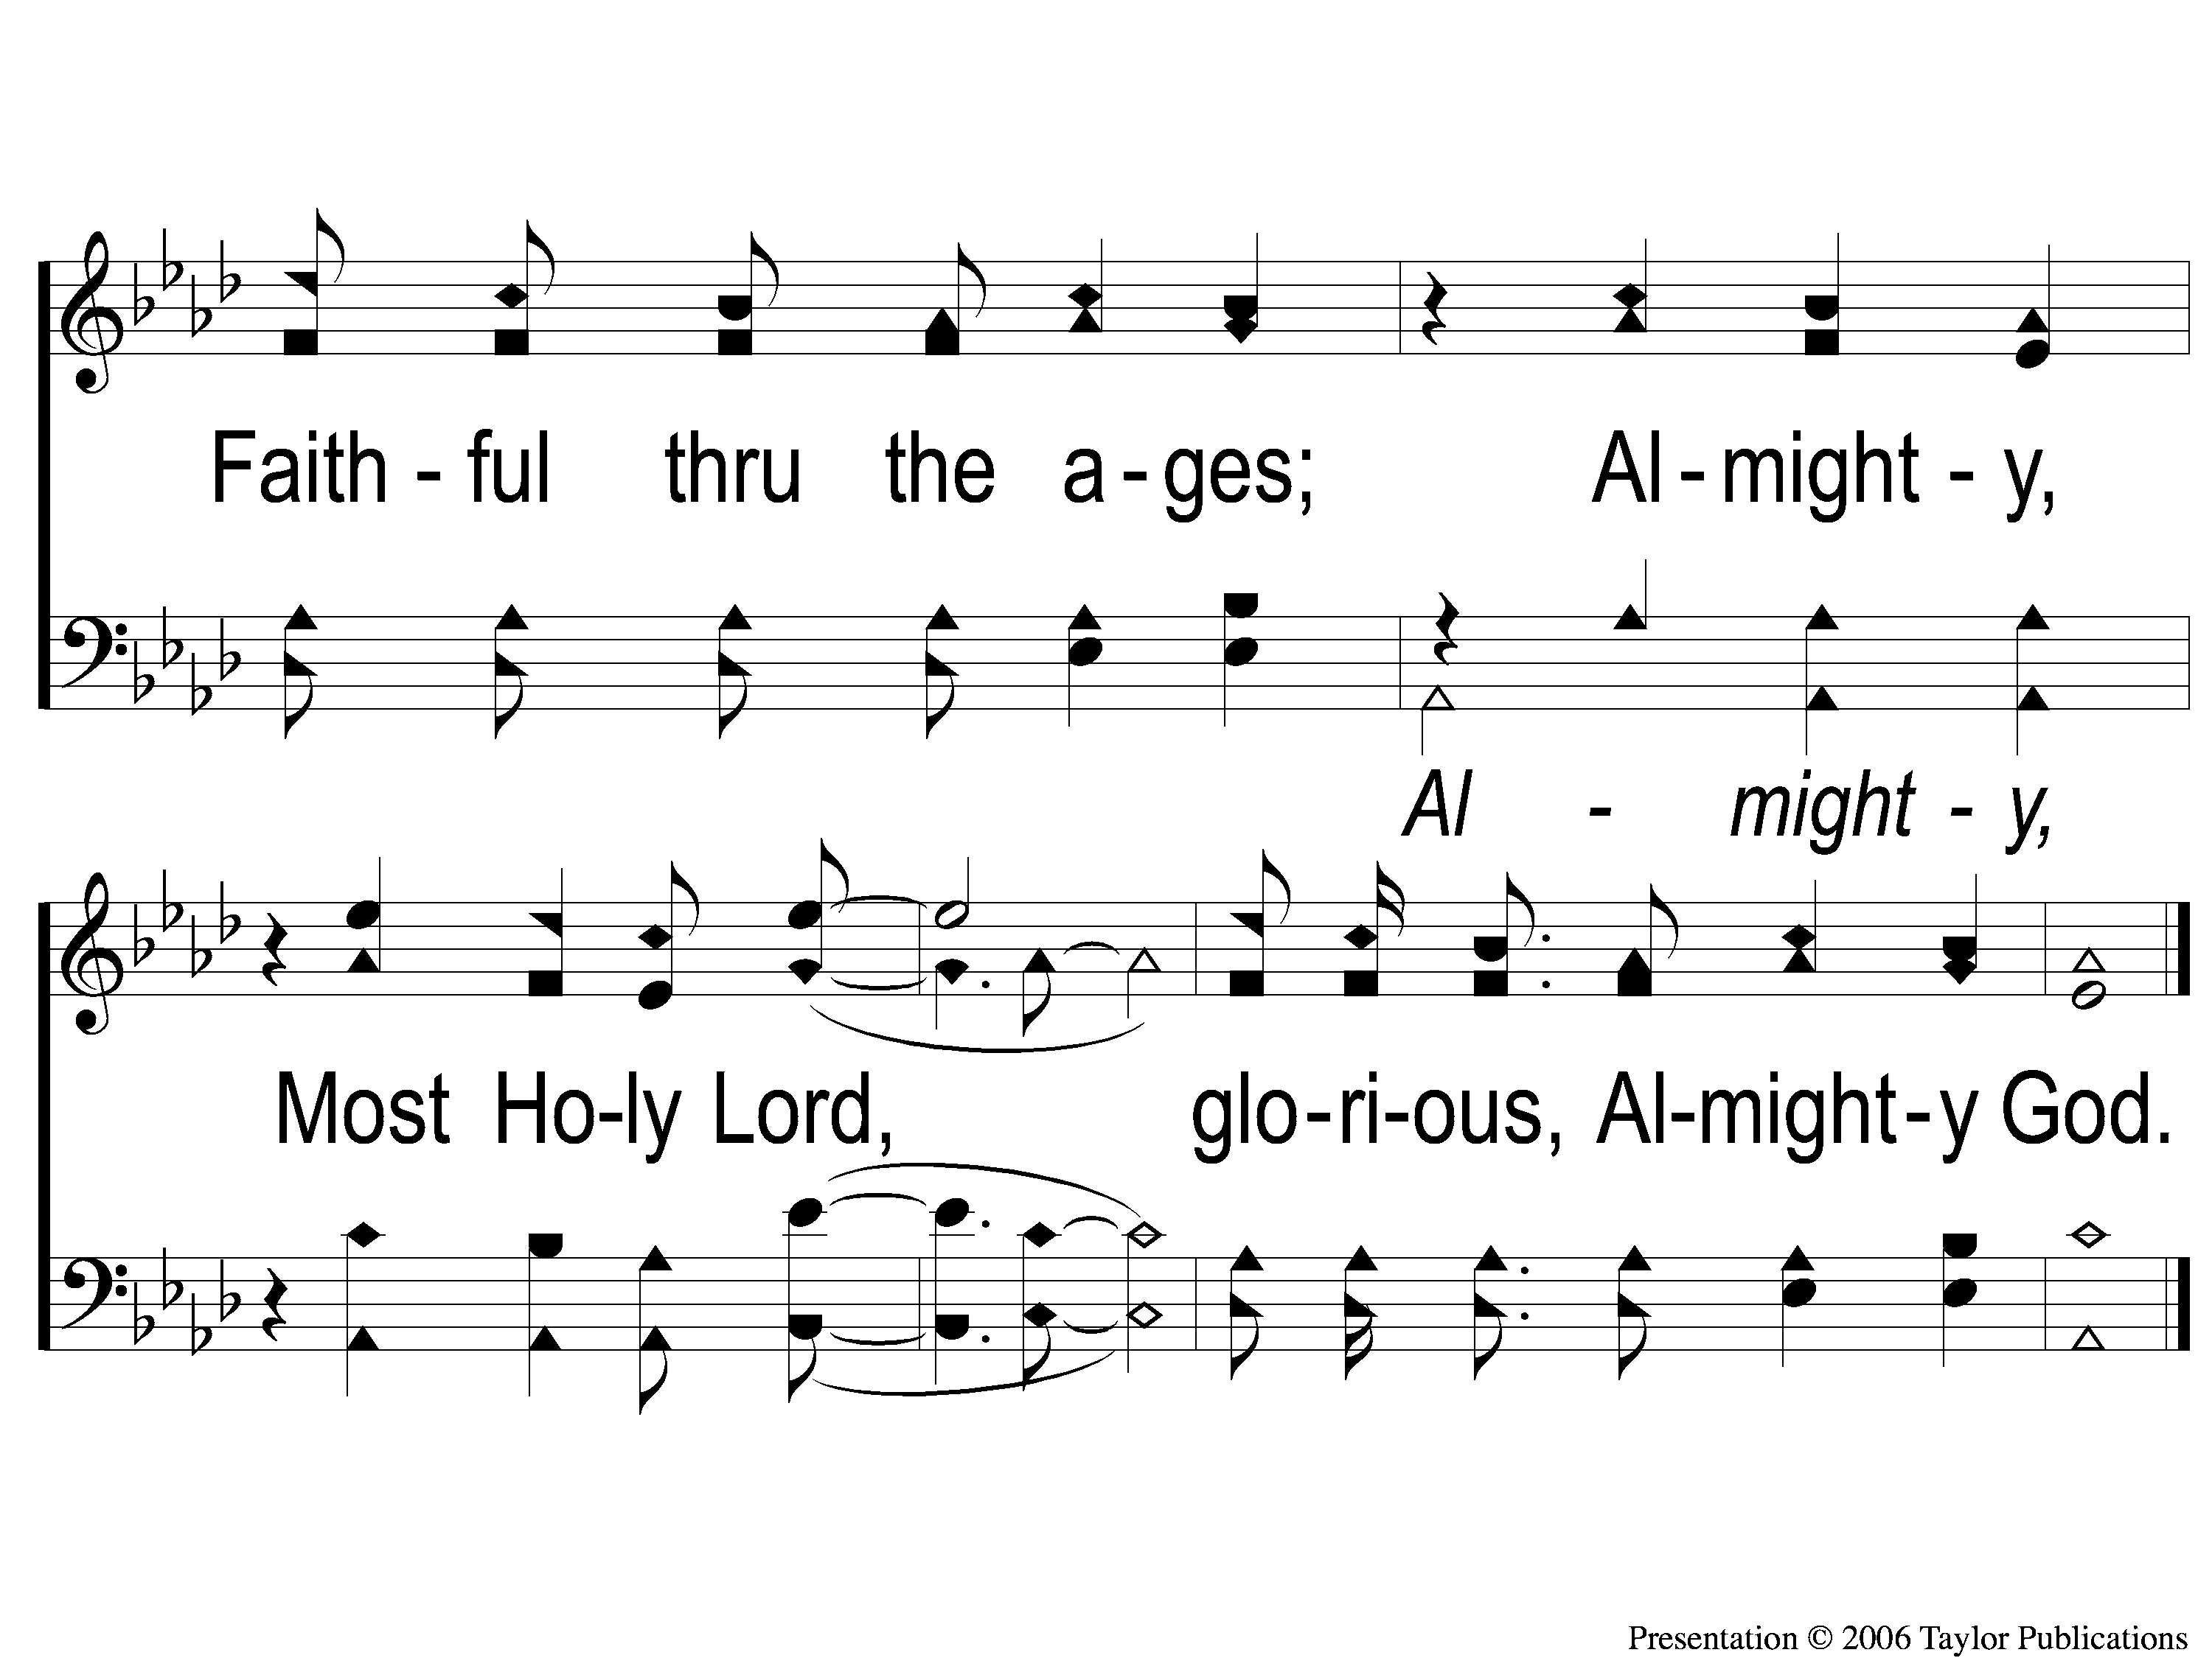
3c-3 Almighty
Almighty
105

